Slide 1
D-OCT

Slide 2
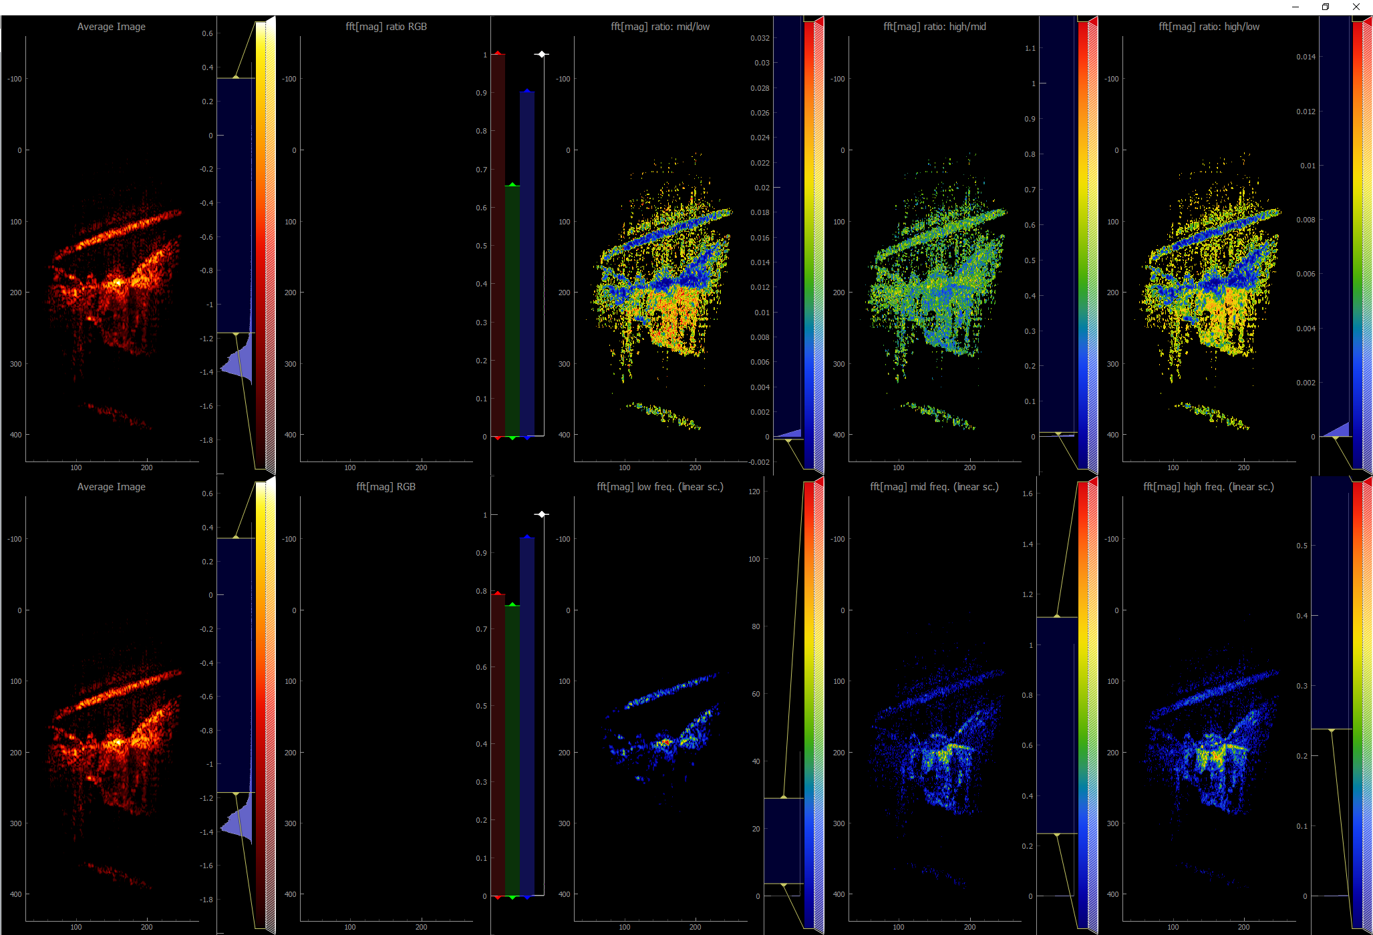
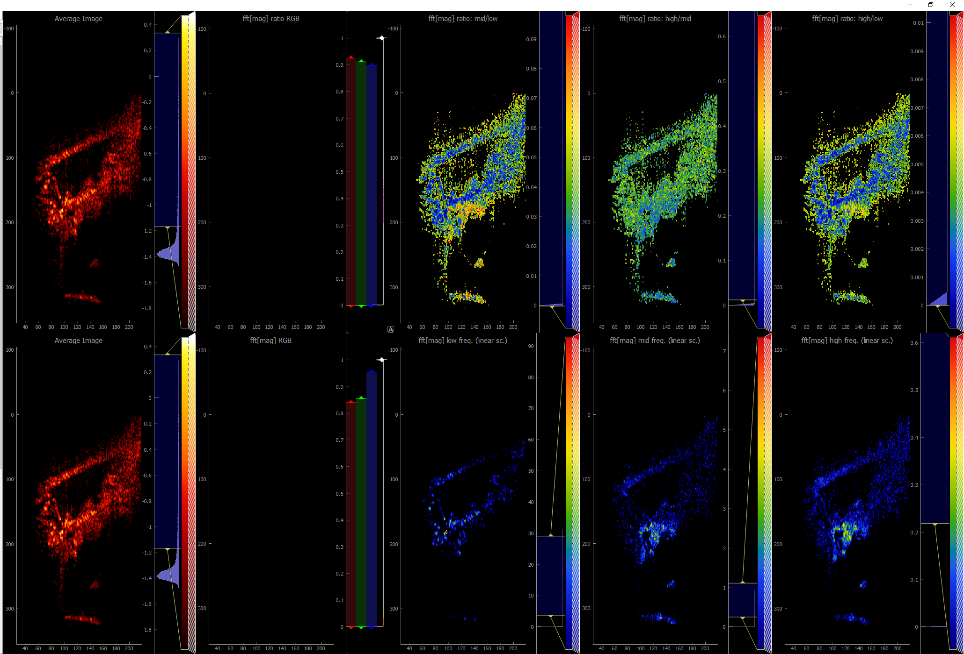
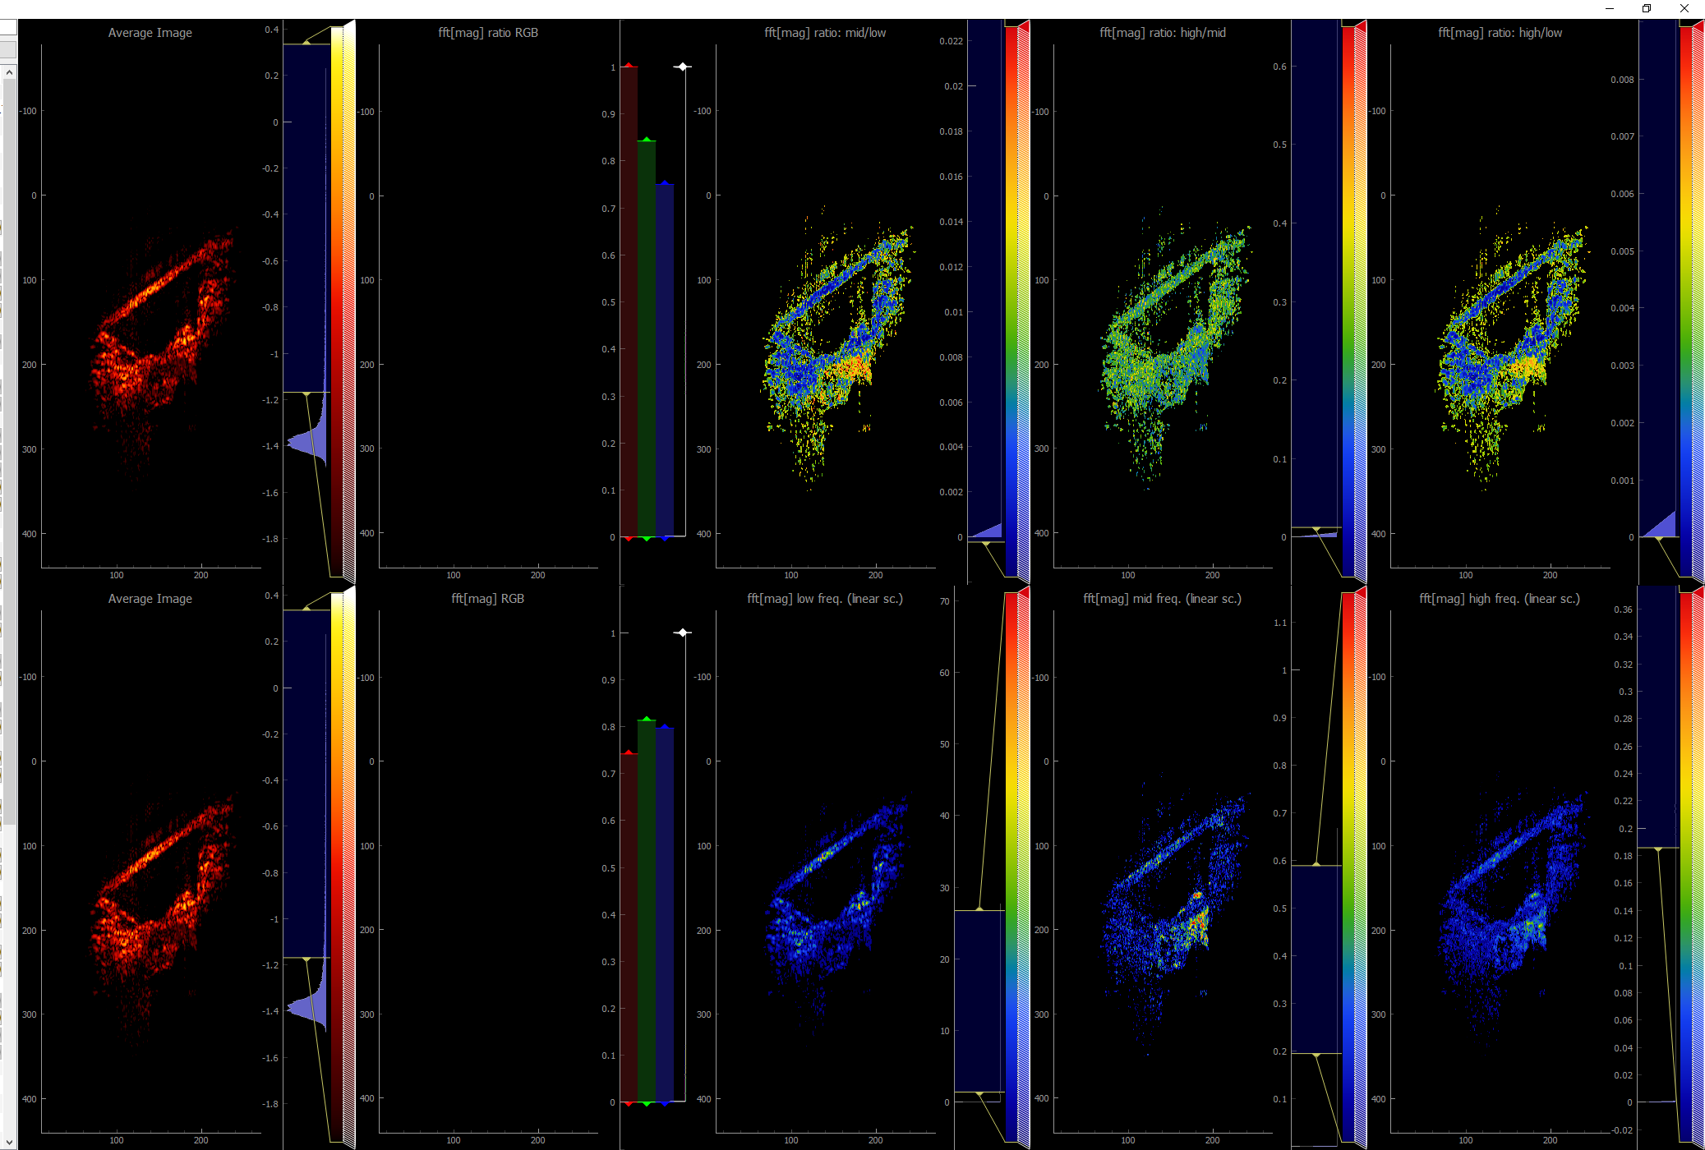
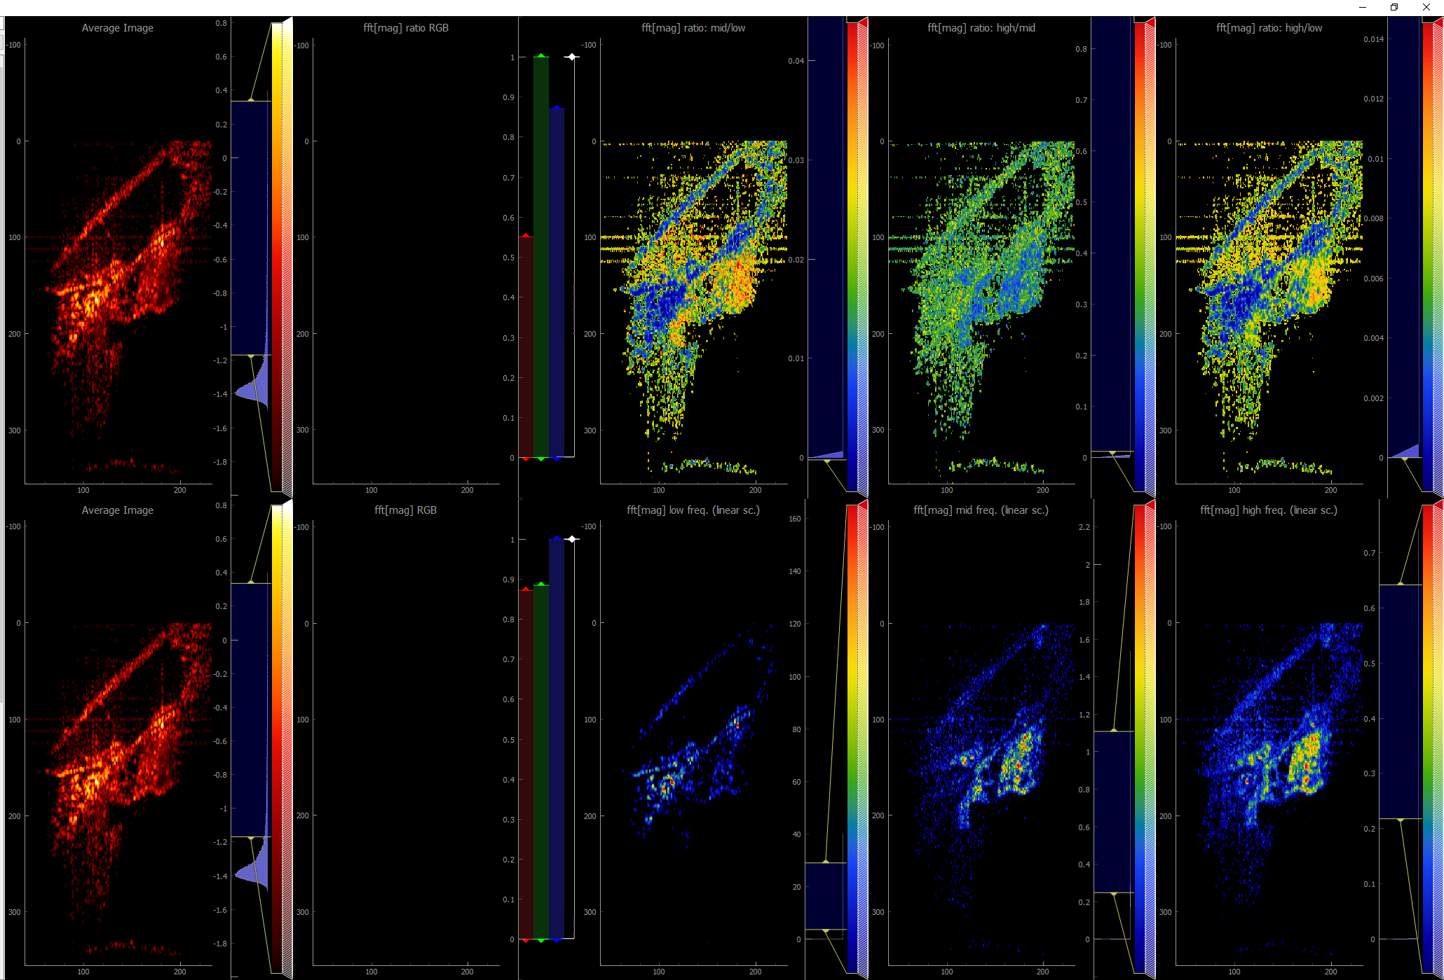
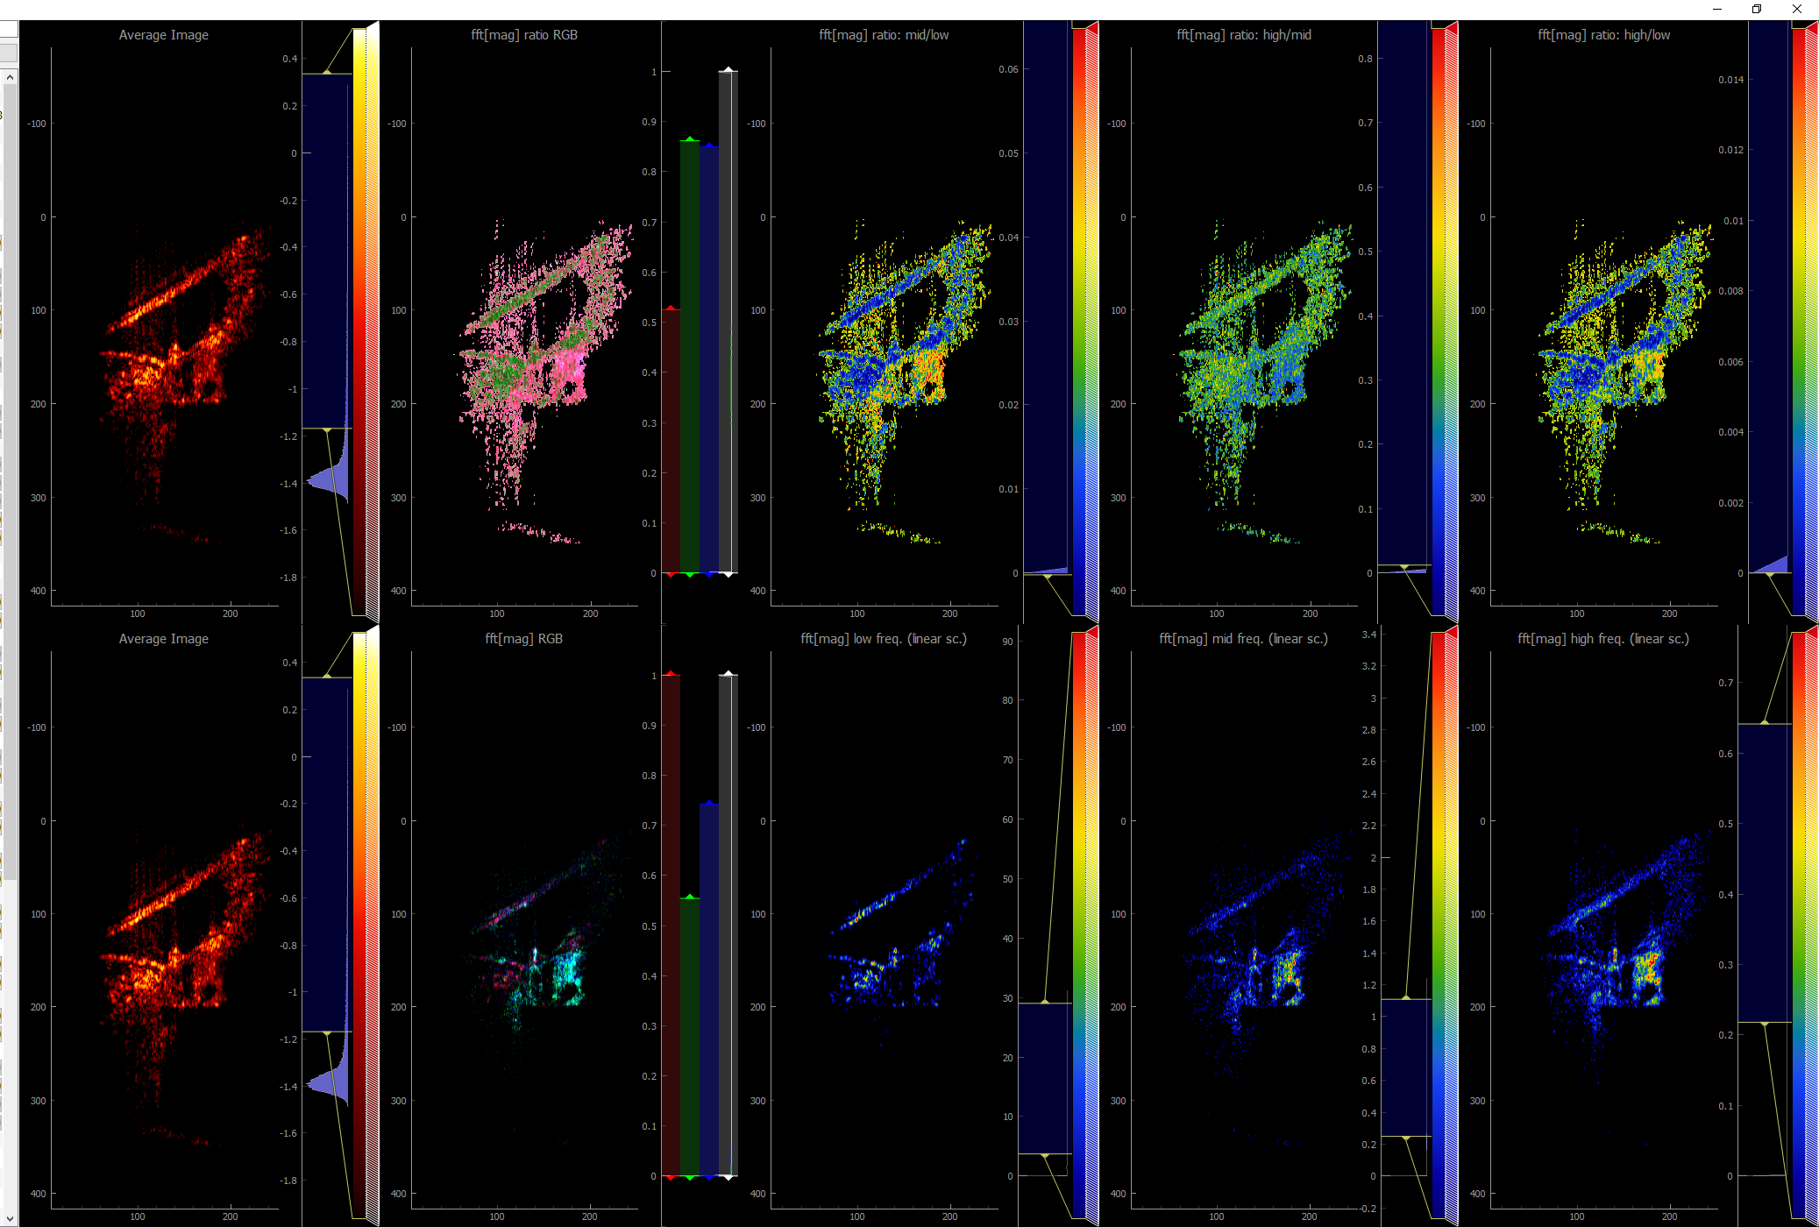
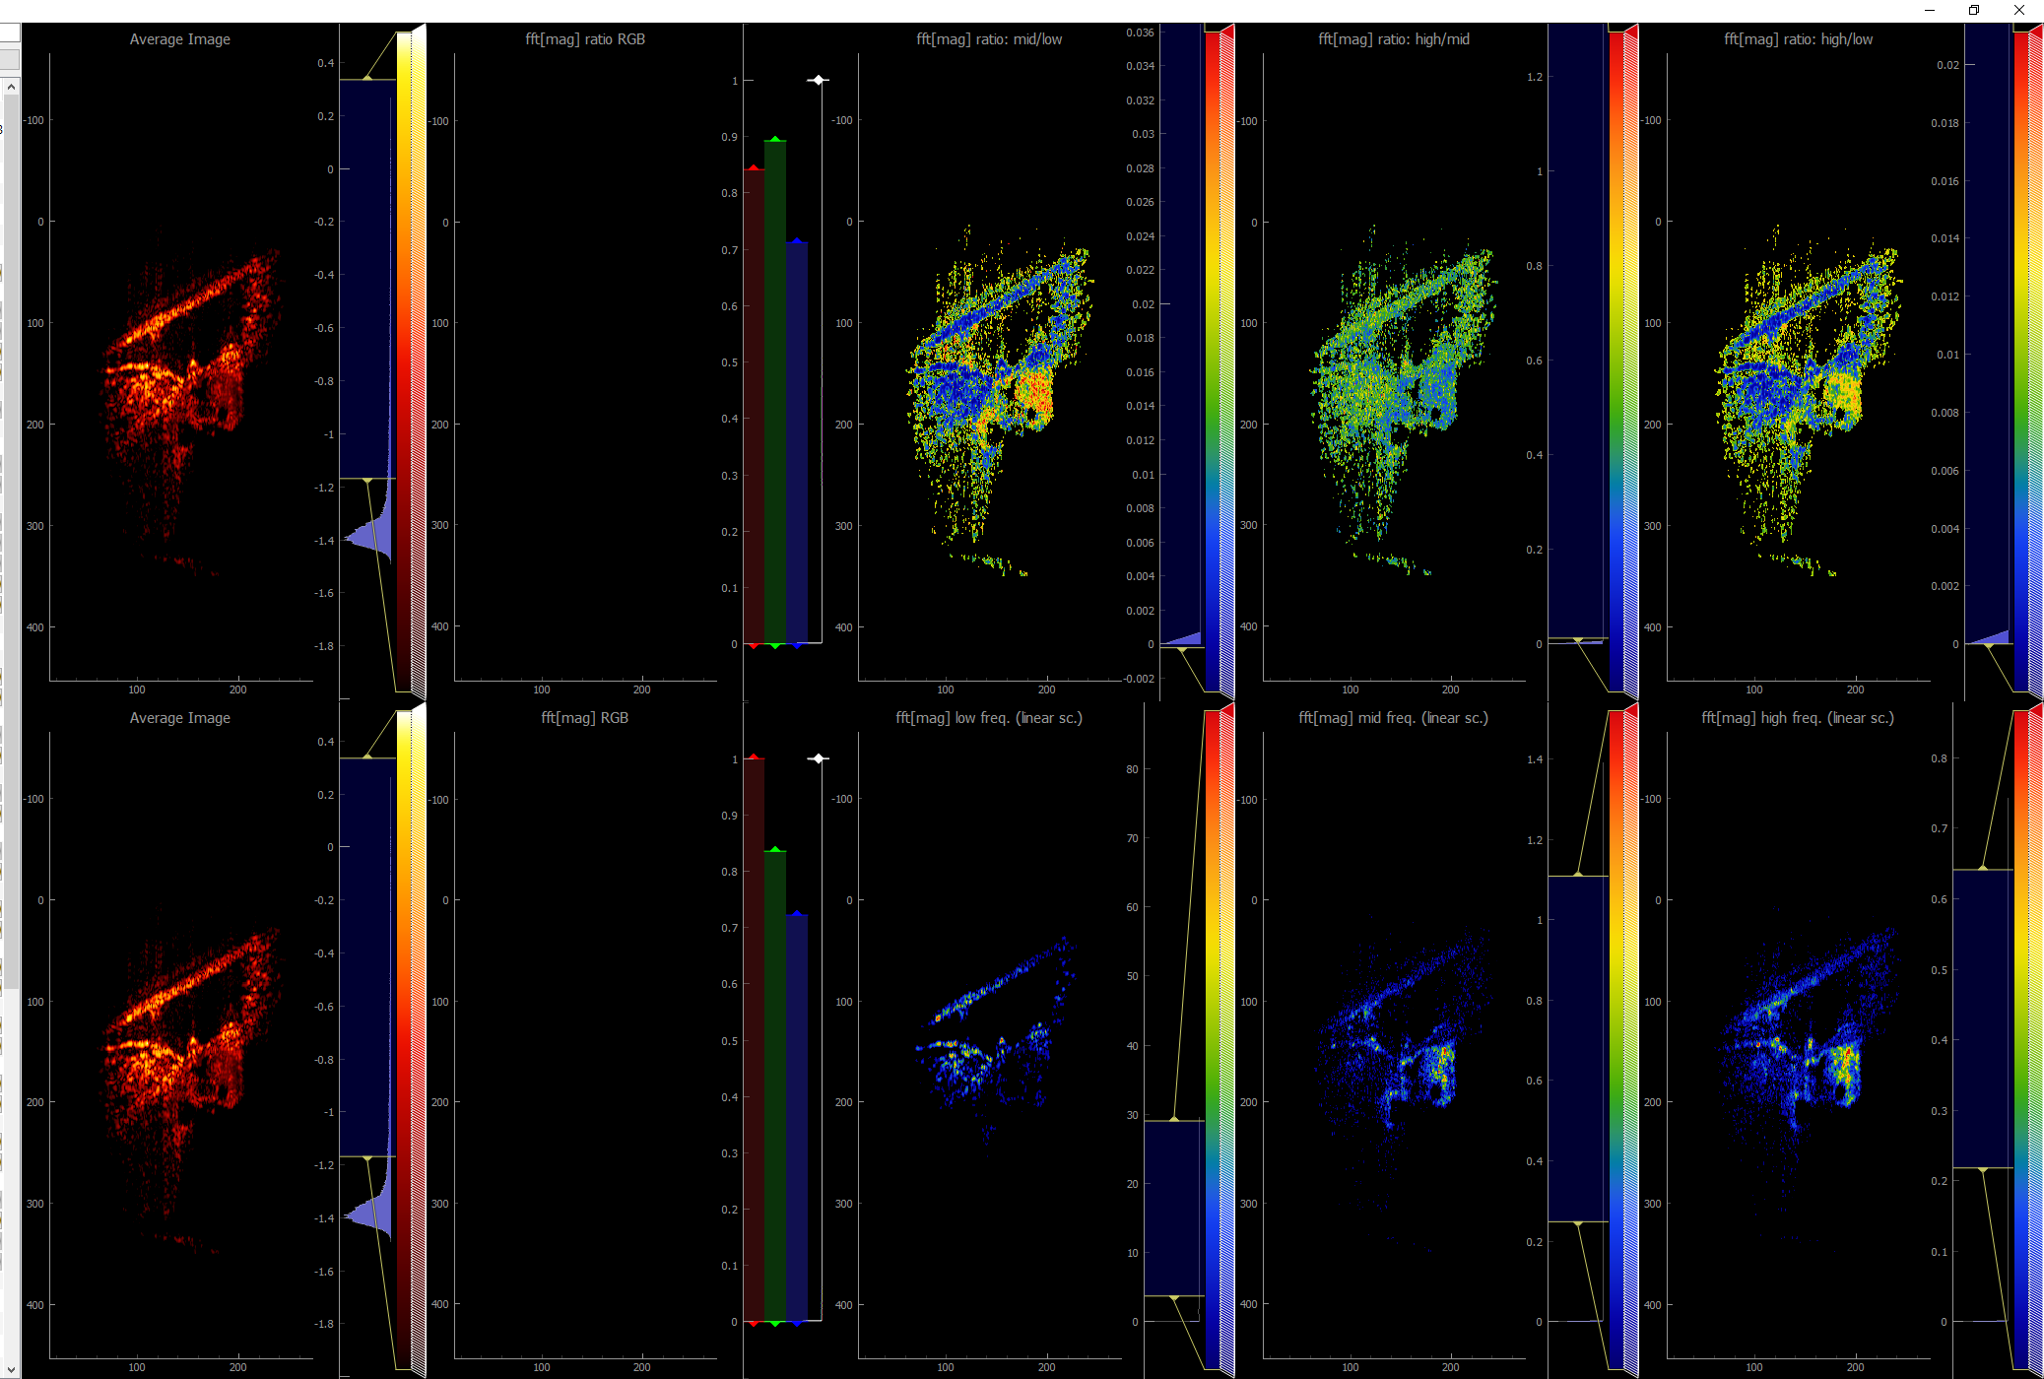
WT
VGLUT3KO
Notes:
0405 FVB/ 0520 CBA/ 0522 CBA
0411 VGLUT3KO 75d/ 0412VGLUT3KO 75d/ 0412 VGLUT3KO 95d

Slide 3
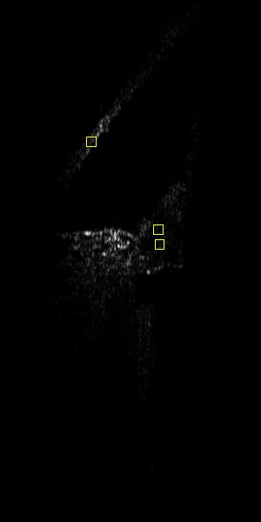
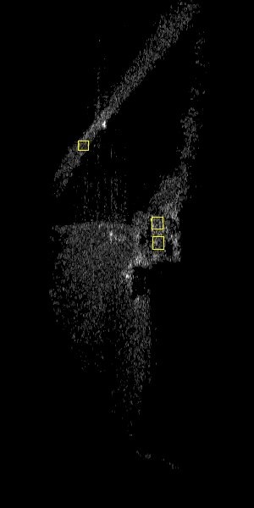
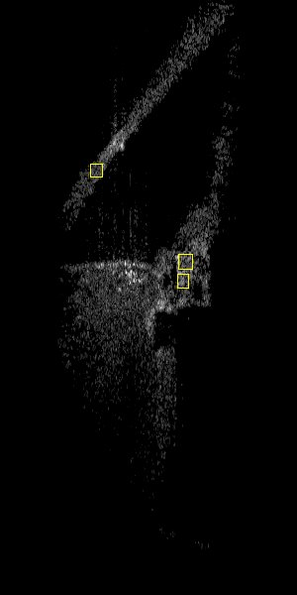
Intensity ratio | Low | Mid | High
OHC/RWM | 0.67 | 1.08 | 1.43
DC/RWM | 0.38 | 1.31 | 1.40
Low
Mid
High
WT:0404 CBA

Slide 4
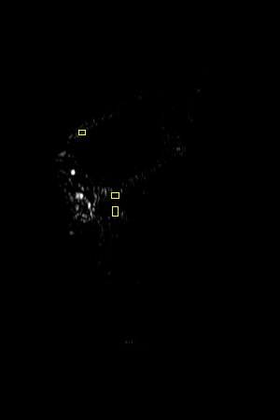
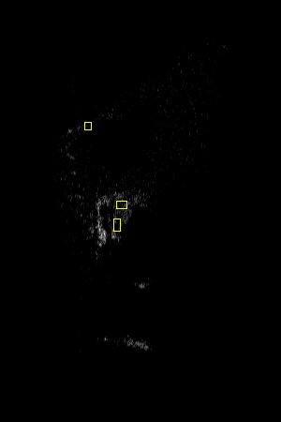
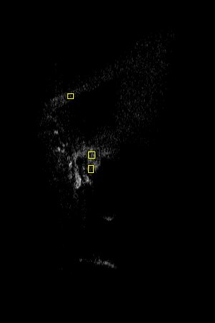
Intensity ratio | Low | Mid | High
OHC/RWM | 0.05 | 1.6 | 1.89
DC/RWM | 0.24 | 1.8 | 3.0
Low
Mid
High
WT:0520 CBA
Notes:
0520 CBA

Slide 5
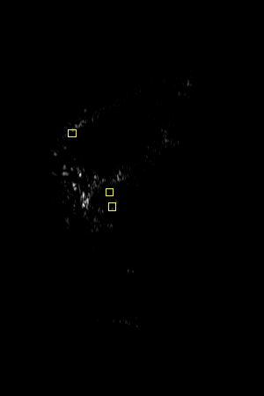
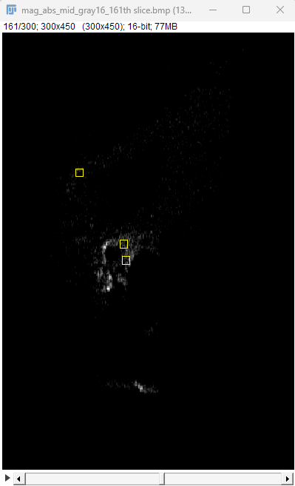
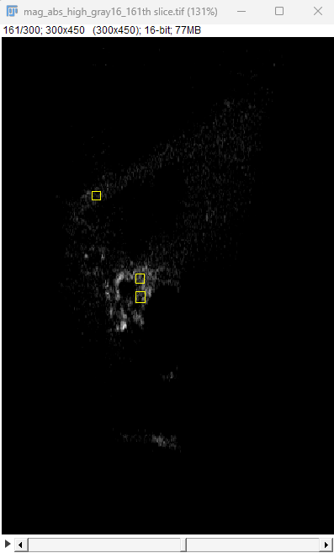
Intensity ratio | Low | Mid | High
OHC/RWM | 0.58 | 2.63 | 2.94
DC/RWM | 0.11 | 2.09 | 3.45
Low
Mid
High
WT:0520 CBA
Reanalysis
Notes:
0520 CBA

Slide 6
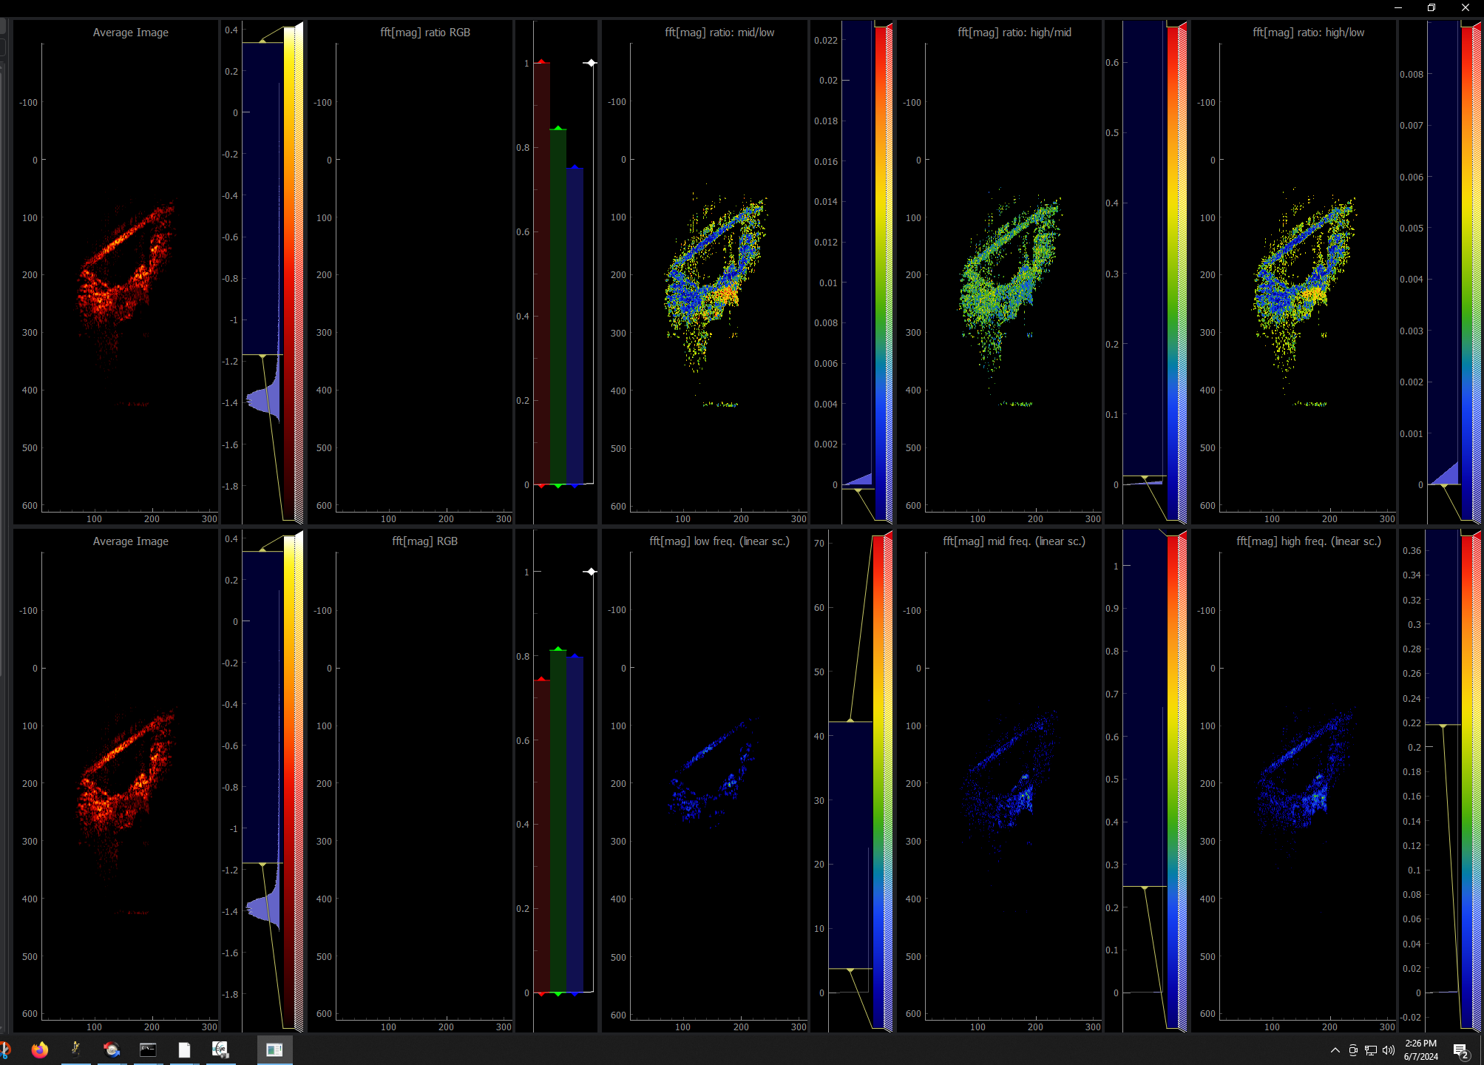
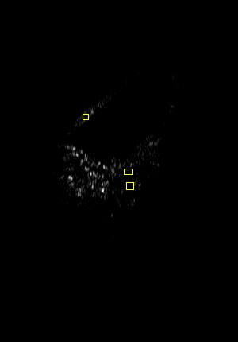
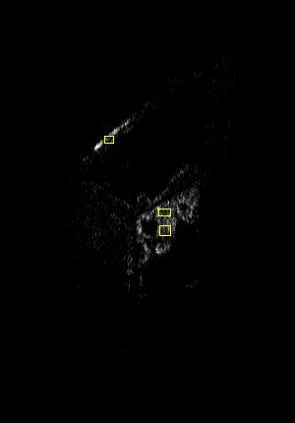
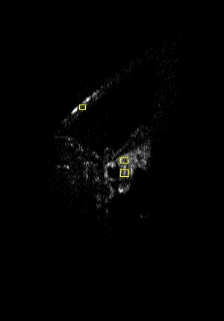
Intensity ratio | Low | Mid | High
OHC/RWM | 0.25 | 1.63 | 1.45
DC/RWM | 0.27 | 1.6 | 1.53
Low
Mid
High
WT:0522 CBA

Slide 7
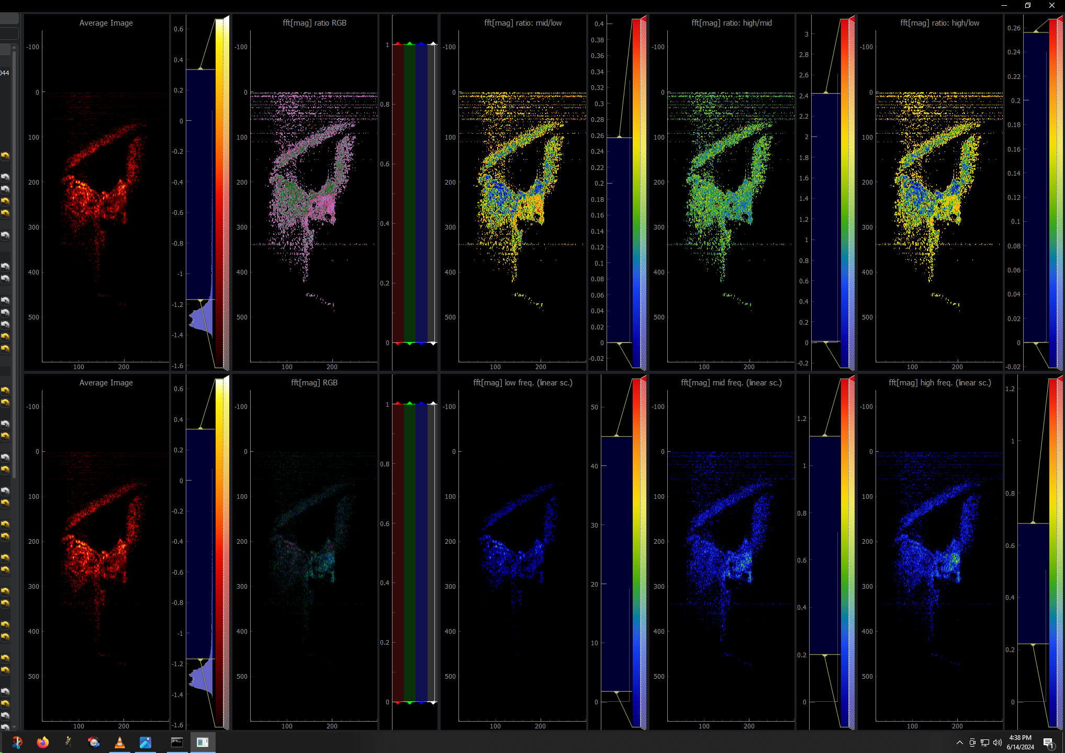
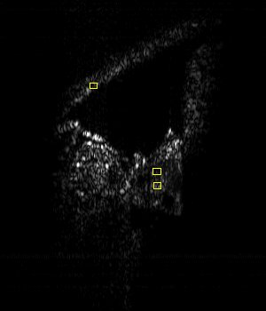
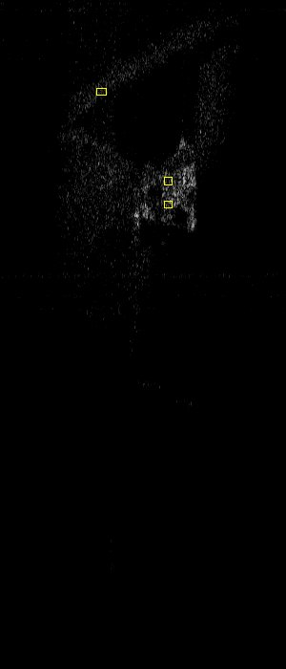
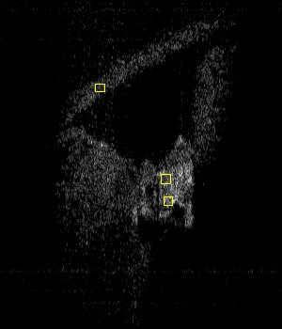
Intensity ratio | Low | Mid | High
OHC/RWM | 1.57 | 2.59 | 2.23
DC/RWM | 0.57 | 1.60 | 1.78
WT:0613 CBA
Low
Mid
High

Slide 8
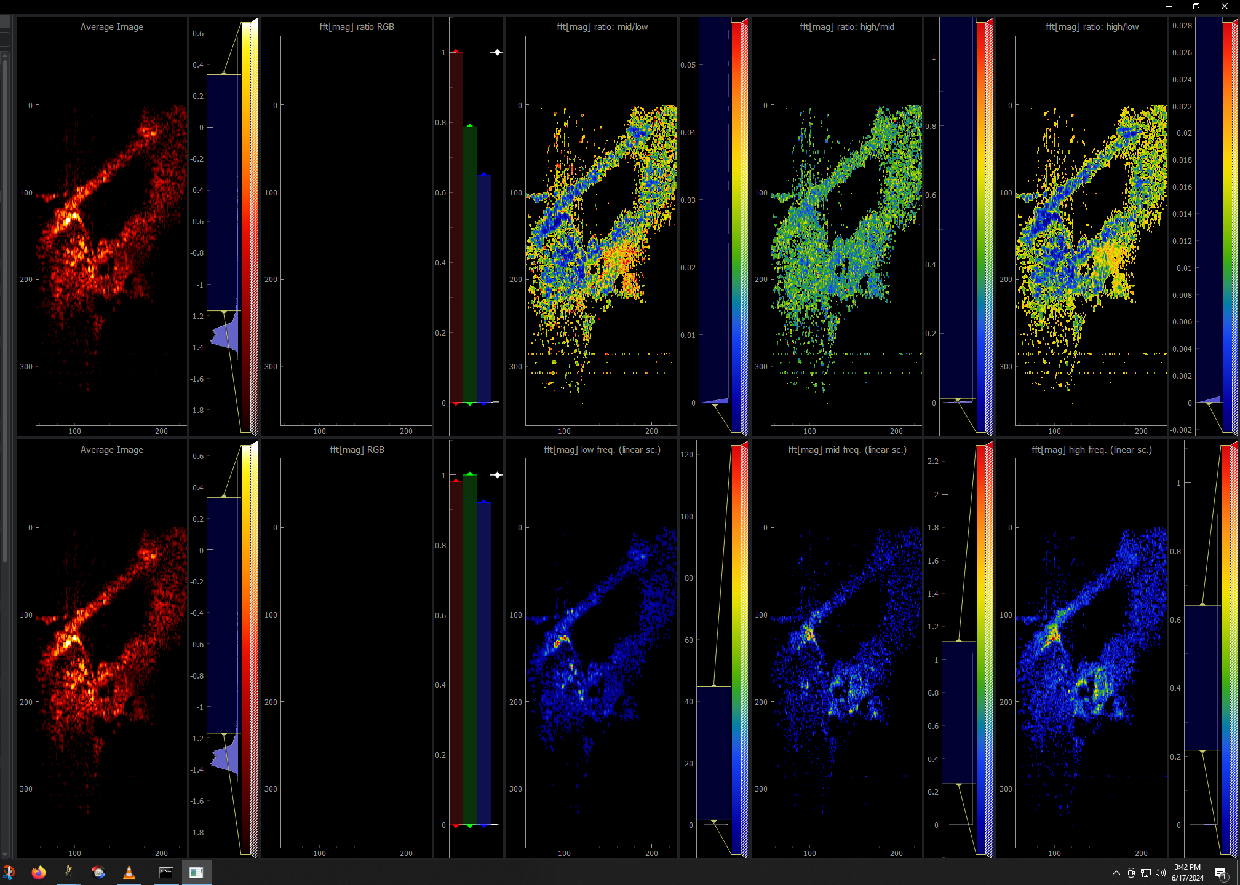
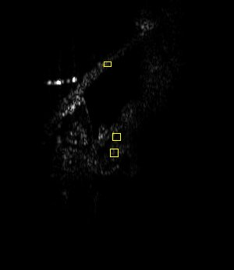
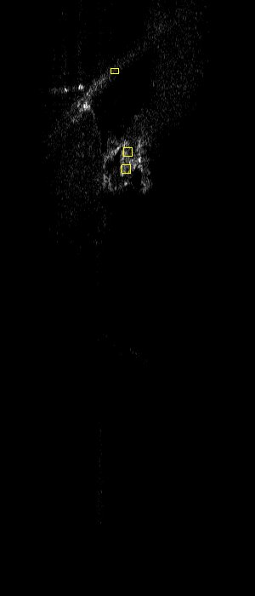
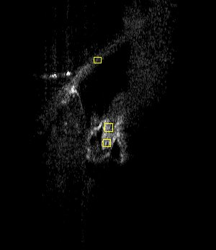
Intensity ratio | Low | Mid | High
OHC/RWM | 0.67 | 3.22 | 2.52
DC/RWM | 0.58 | 2.79 | 2.49
WT:0614 CBA
Low
Mid
High

Slide 9
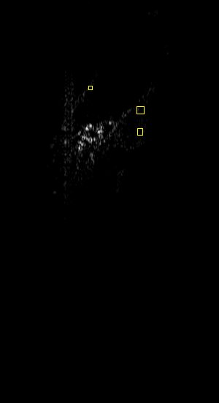
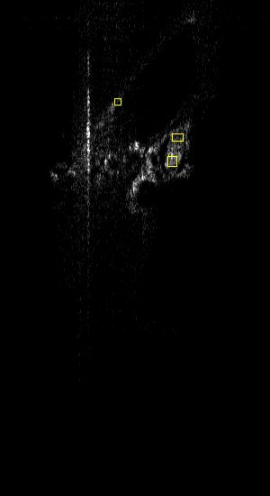
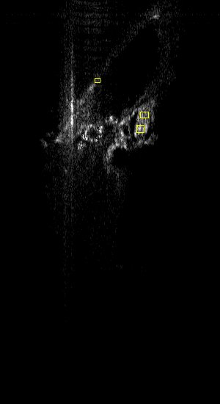
Intensity ratio | Low | Mid | High
OHC/RWM | 2.82 | 4.84 | 4.2
DC/RWM | 1.18 | 2.08 | 2.7
Low
Mid
High
VGLUT3KO:0411 75d

Slide 10
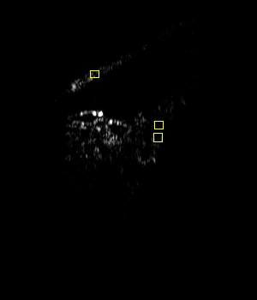
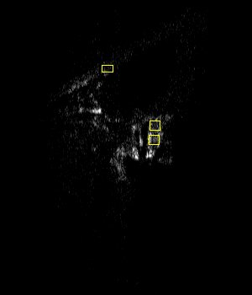
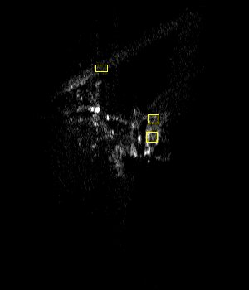
Intensity ratio | Low | Mid | High
OHC/RWM | 0.22 | 5.86 | 3.8
DC/RWM | 0.02 | 3.27 | 2.3
Low
Mid
High
VGLUT3KO:0412(13) 95d

Slide 11
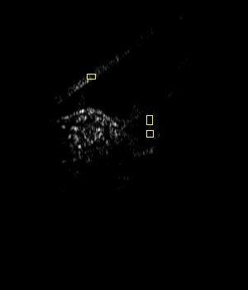
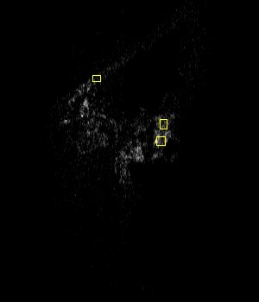
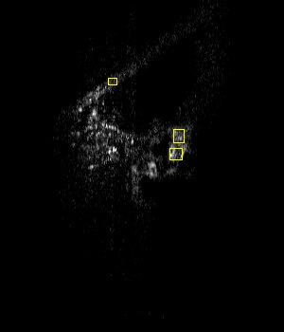
Intensity ratio | Low | Mid | High
OHC/RWM | 0.1 | 4.49 | 2.0
DC/RWM | 0.02 | 2.94 | 1.8
Low
Mid
High
VGLUT3KO:0412(14) 75d

Slide 12
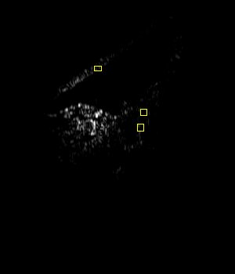
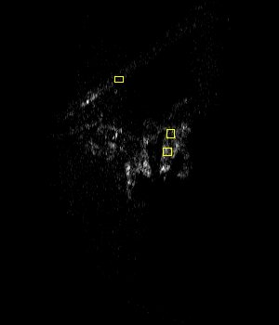

Reanalysis: 159th slice
Intensity ratio | Low | Mid | High
OHC/RWM | 0.68 | 9.14 | 5.1
DC/RWM | 0.05 | 3.94 | 2.8
Low
Mid
High
VGLUT3KO:0412(14) 75d

Slide 13
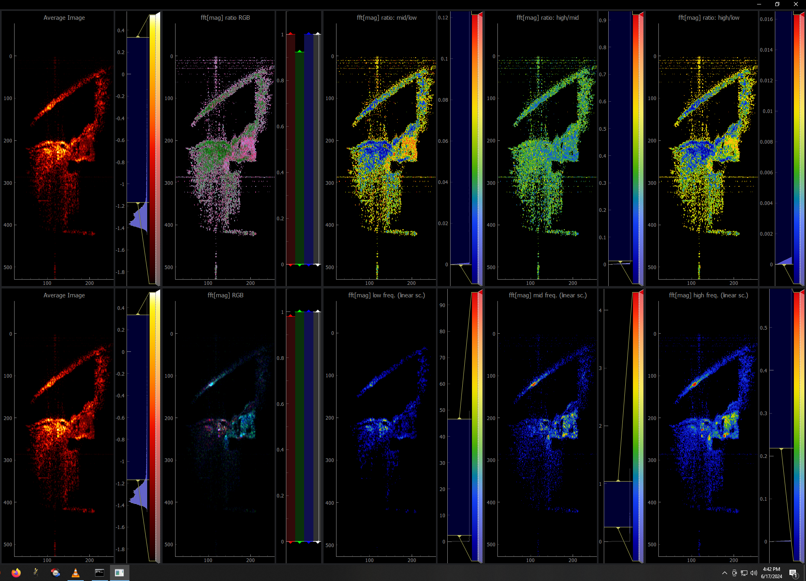
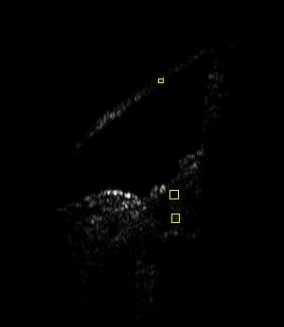
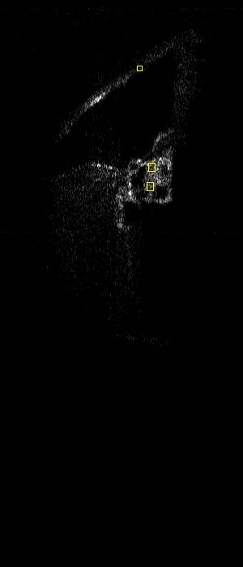
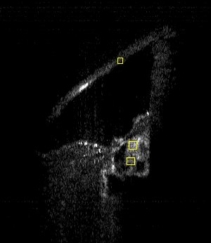
Intensity ratio | Low | Mid | High
OHC/RWM | 0.78 | 3.45 | 2.35
DC/RWM | 0.21 | 4.66 | 3.54
Low
Mid
High
VGLUT3KO:0617 85d

Slide 14
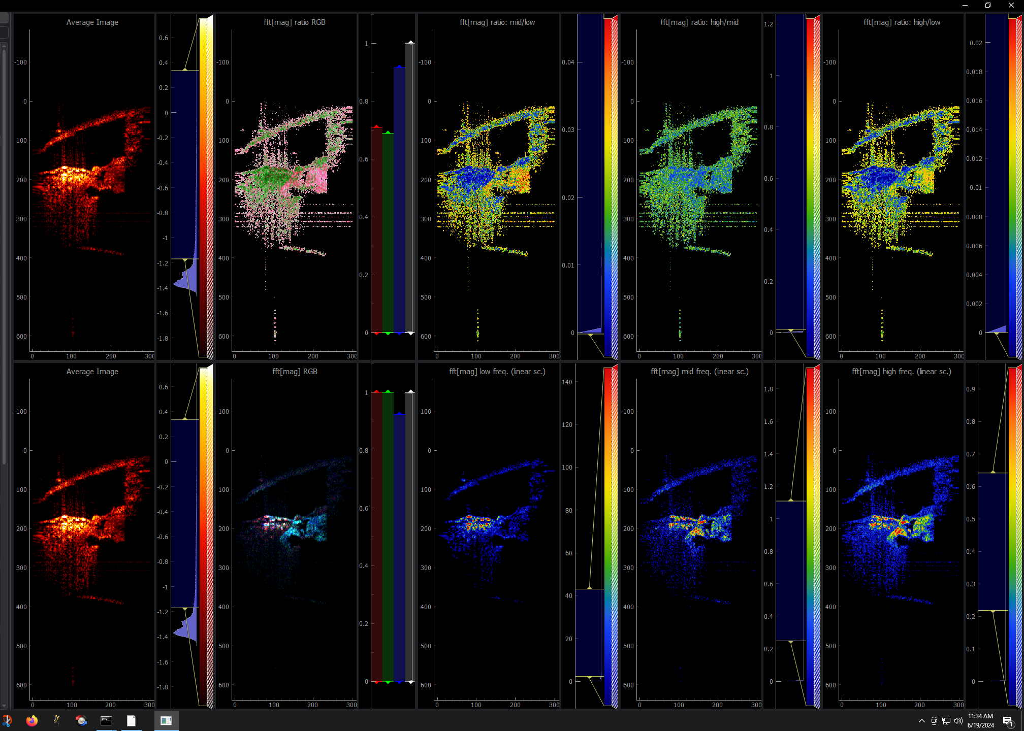
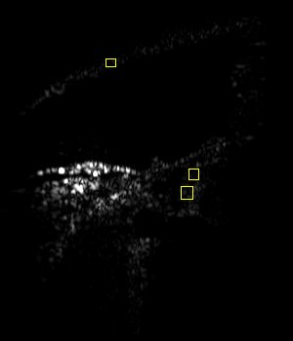
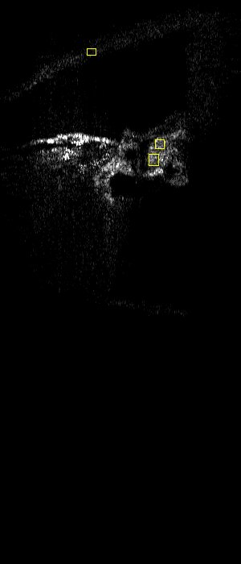
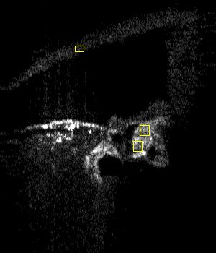
Intensity ratio | Low | Mid | High
OHC/RWM | 2.89 | 7.62 | 3.43
DC/RWM | 1.46 | 8.03 | 4.00
Low
Mid
High
VGLUT3KO:0619

Slide 15
Low: <5Hz
WT
VGLUT3KO

Slide 16
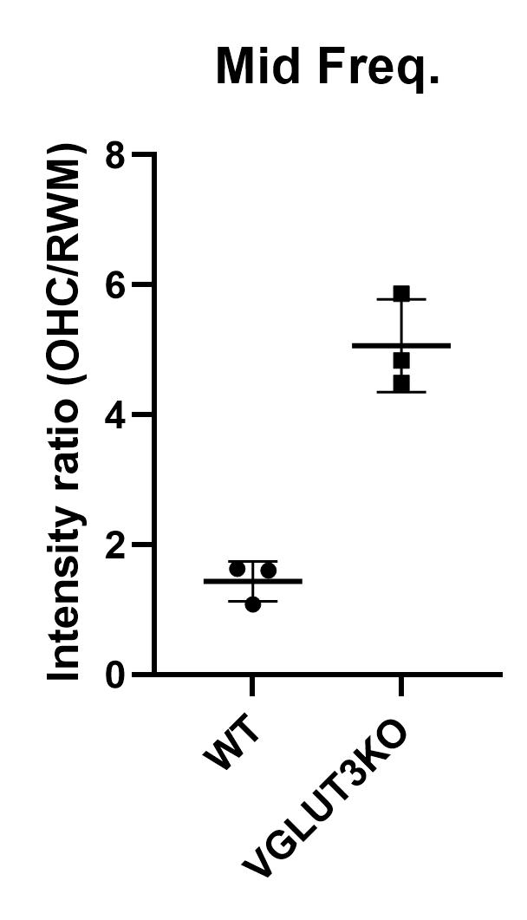
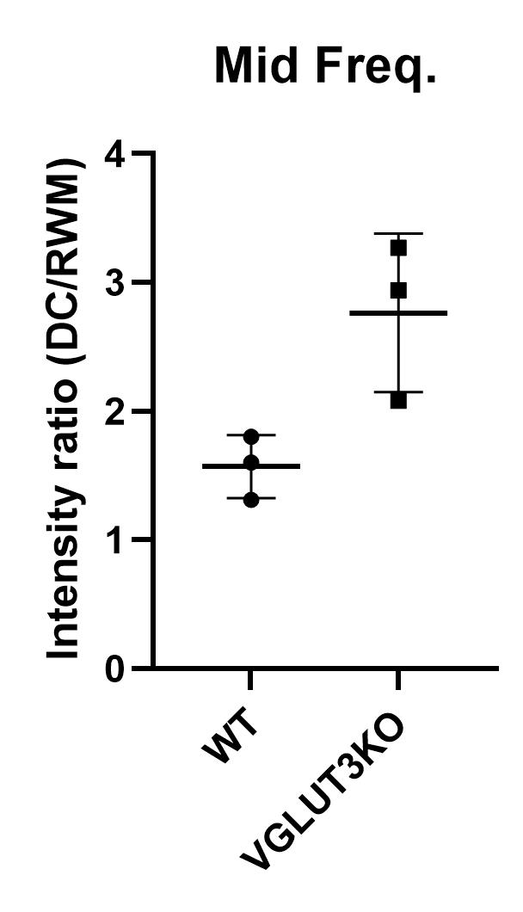
Mid: 5Hz-15Hz
WT
VGLUT3KO

Slide 17
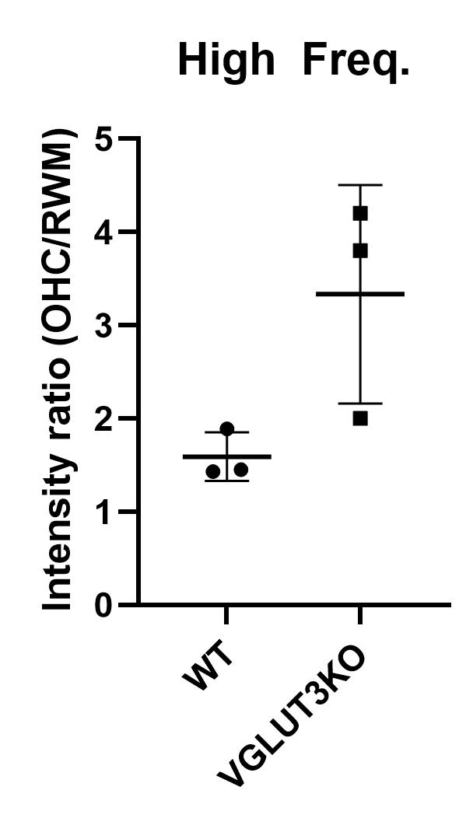
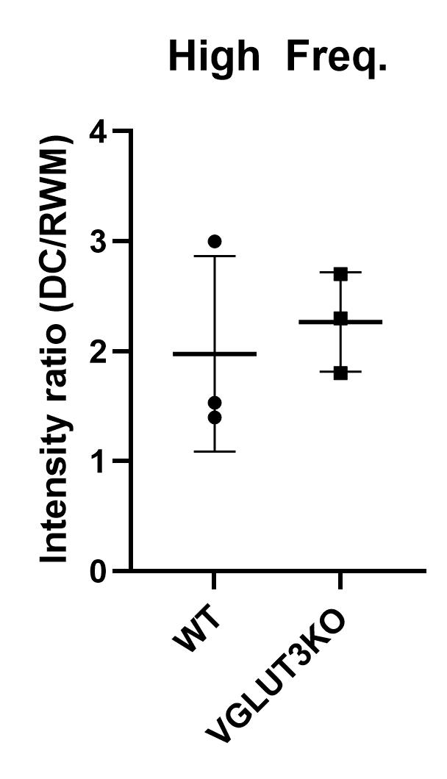
High: >15Hz
WT
VGLUT3KO

Slide 18


Mid: 5Hz-15Hz updated
WT
VGLUT3KO

Slide 19


High: >15Hz
updated
WT
VGLUT3KO

Slide 20


Mid: 5Hz-15Hz updated (n=5)
WT
VGLUT3KO

Slide 21


High: >15Hz
Updated (n=5)
WT
VGLUT3KO

